Slide 1
CA2 Report
Deep Learning in Medical Ultrasound Images
Speaker： Wu Hao

Slide 2
Introduction
Literature Review
Experiments
Results and Discussion
Future Recommendations
CONTENTS
1

Slide 3

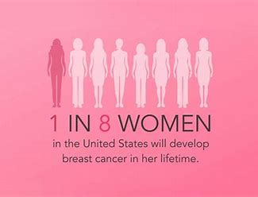
Breast cancer
A stable, time-saving, robust, objective, and intelligent diagnosis system is needed.
2

Slide 4
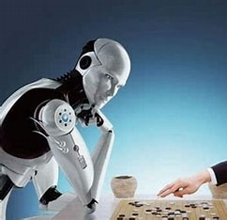
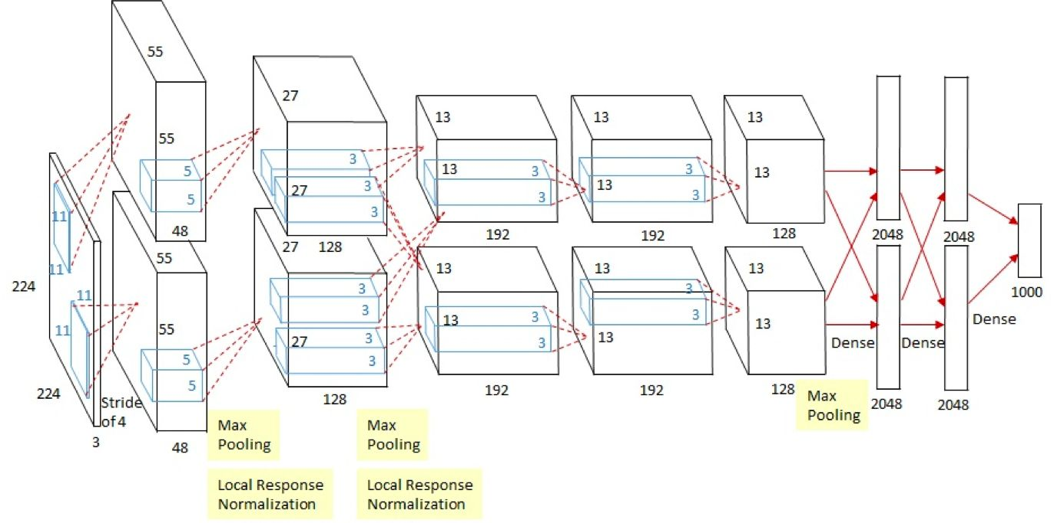
Deep Learning
Lee Sedol was defeated by Alpha Go with the score of 4:1
AlexNet won the 2012 ImageNet Large Scale Visual Recognition Challenge (ILSVRC)
3

Slide 5
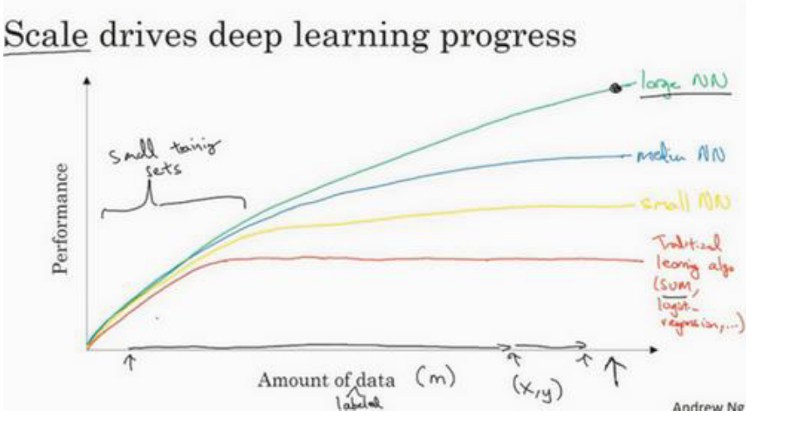

Our goals
Deep learning may become a effective solution.
However, the lack of medical image data limits the application and performance of deep learning in the medical field.
My FYP aims to solve the problem of lacking dataset in some degrees. And, we are going to use GANs for data augmentation in the project.
4

Slide 6
Introduction
Literature Review
Experiments
Results and Discussion
Future Recommendations
CONTENTS
5

Slide 7
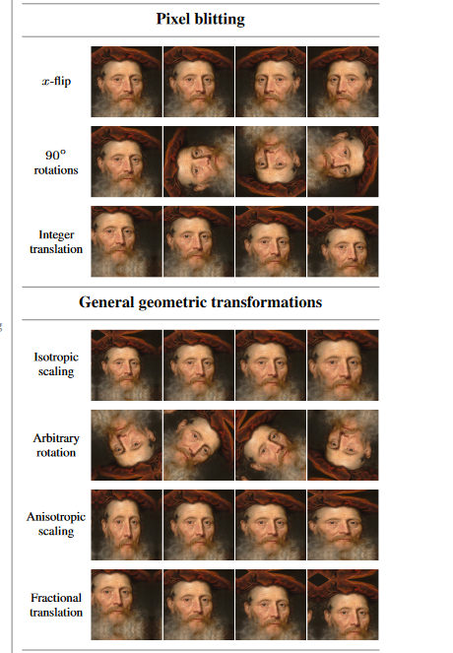
The basic augmentation techniques include geometric transformations, cropping, erasing, intensity operations, noise injection, and filtering.
The GAN model is first published by Goodfellow in 2014.
Alberto Montero Agudo, Zong Fan, Daiqing Li and Christopher Bowles made great contributions in medical data augmentation area.
6

Slide 8
Introduction
Literature Review
Experiments
Results and Discussion
Future Recommendations
CONTENTS
7

Slide 9
Dataset
The dataset is BUSI dataset, which is available at https://scholar.cu.edu.eg/?q=afahmy/pages/dataset.
780 images
about 500×500 pixels
benign, normal, and malignant
We only selected benign and malignant part and resized them all into 256×256 pixels
8

Slide 10
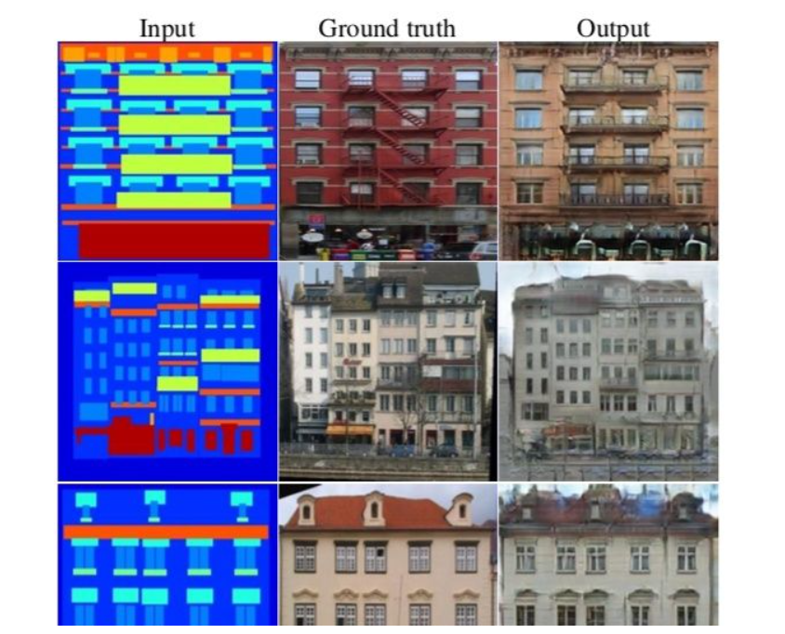
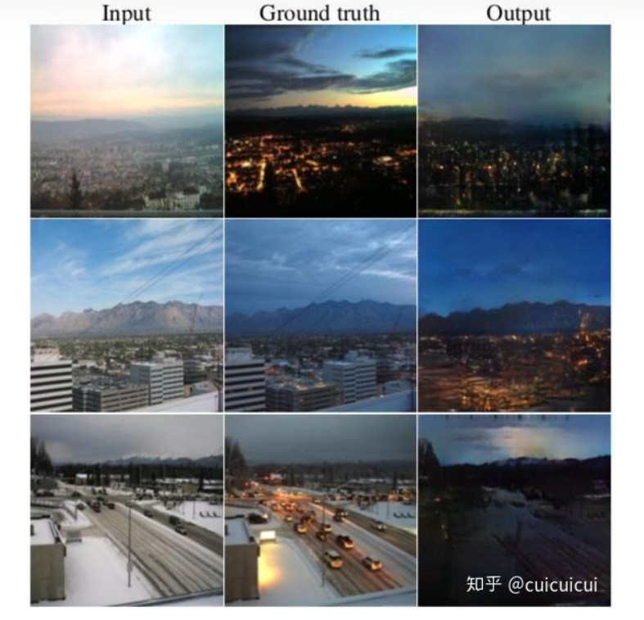
Image-to-image translation
Image to Image translation means generate pictures from one domain to another domain, so it can solve a lot of problems. For example, label to image, style transformation, picture repatriation, and so on. Pix2PixHD is the model for image-to-image translation tasks.
9

Slide 11
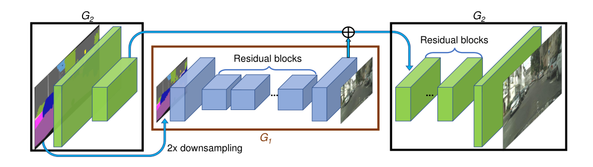
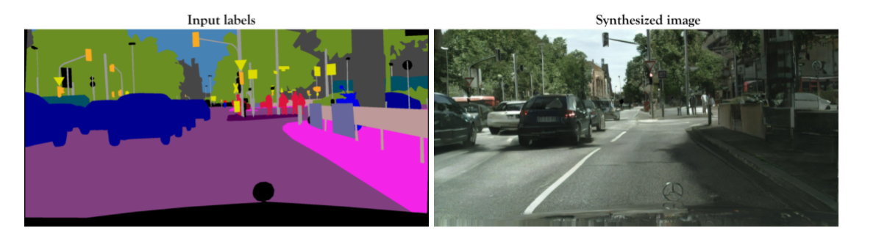
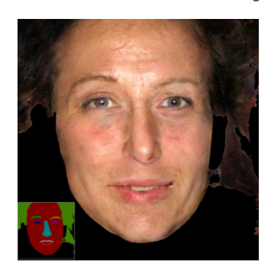
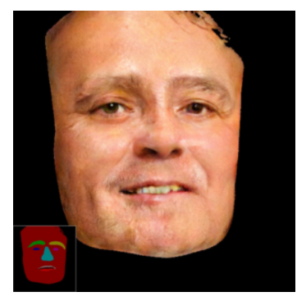
Pix2PixHD
Pix2PixHD solves the problem that Pix2Pix is hard to train while the results look strange in detail and lack of realistic textures. And the pictures here show its structure, performance and objective equation.
10

Slide 12
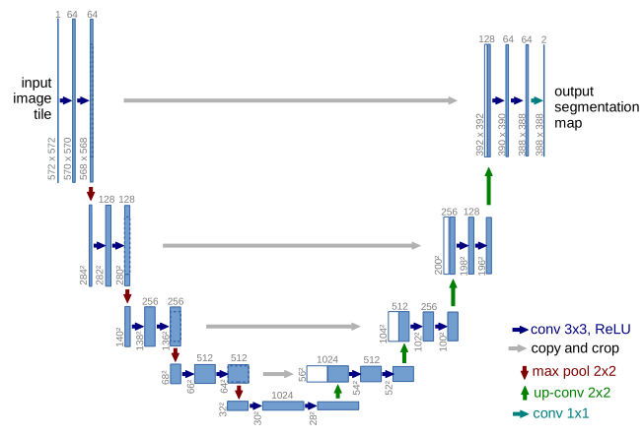
Unet
Under-sampling: 2 times 3*3 convolutional layer, ReLU function and 2*2 maxpooling
Up-sampling: 2*2 transposed convolutional layer, 2 times 3*3 convolutional layer
BUSIseg.html
11

Slide 13
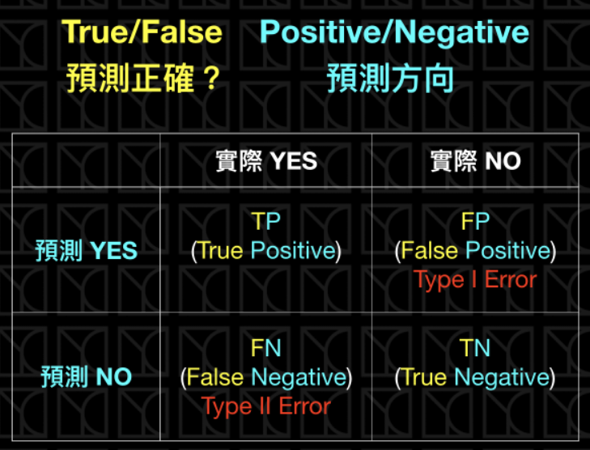
Evaluation Metrics
Confusion Matrix
12

Slide 14
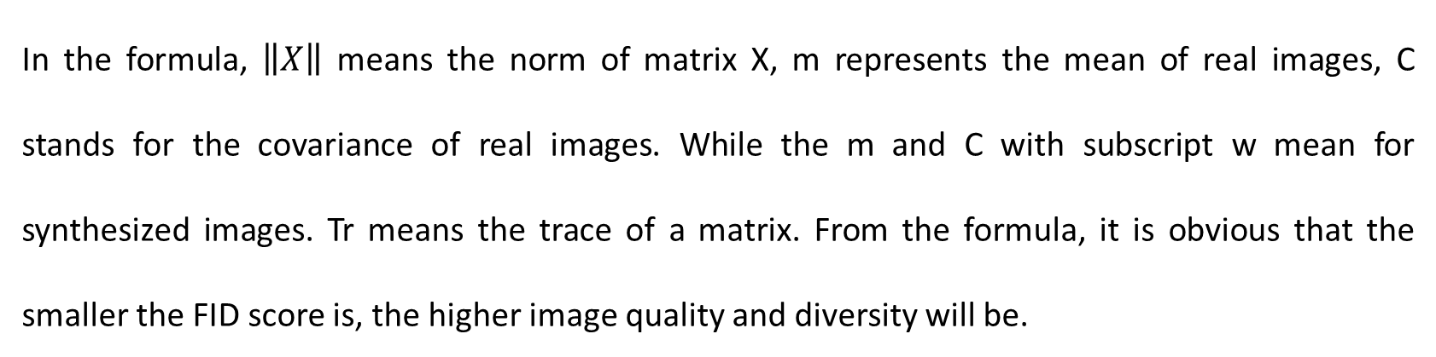
FID Score
In the formula, $\left\|X\right\|$ means the norm of matrix X, m represents the mean of real images, C stands for the covariance of real images. While the m and C with subscript w mean for synthesized images. Tr means the trace of a matrix. From the formula, it is obvious that the smaller the FID score is, the higher image quality and diversity will be.
13

Slide 15
Experiment Procedures
Use geometric transformation augmentation techniques to generate synthesized masks.
Use the Pix2PixHD model to generate synthesized images and evaluate the performance of results by FID score.
Combine the real dataset and synthesized dataset and then use the Unet to train the combined dataset and test its performance using evaluation metrics
14

Slide 16
Introduction
Literature Review
Experiments
Results and Discussion
Future Recommendations
CONTENTS
15

Slide 17
Pix2PixHD Generation
Best epoch and FID score of three conditions
16

Slide 18
Unet Segmentation
BUSI’s best segmentation results in different augmentations
Segmentation results on different Pix2PixHD conditions
17

Slide 19
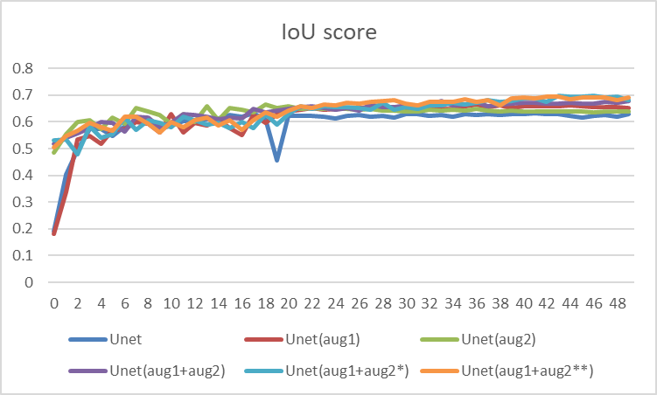
Discussion
Both data augmentation methods work
Lower FID score, higher performance, but nonlinear.
Limitations
Without testing its generalization ability
Cannot generate normal images
Features loss
Augmentation methods may not correspond to reality
18

Slide 20
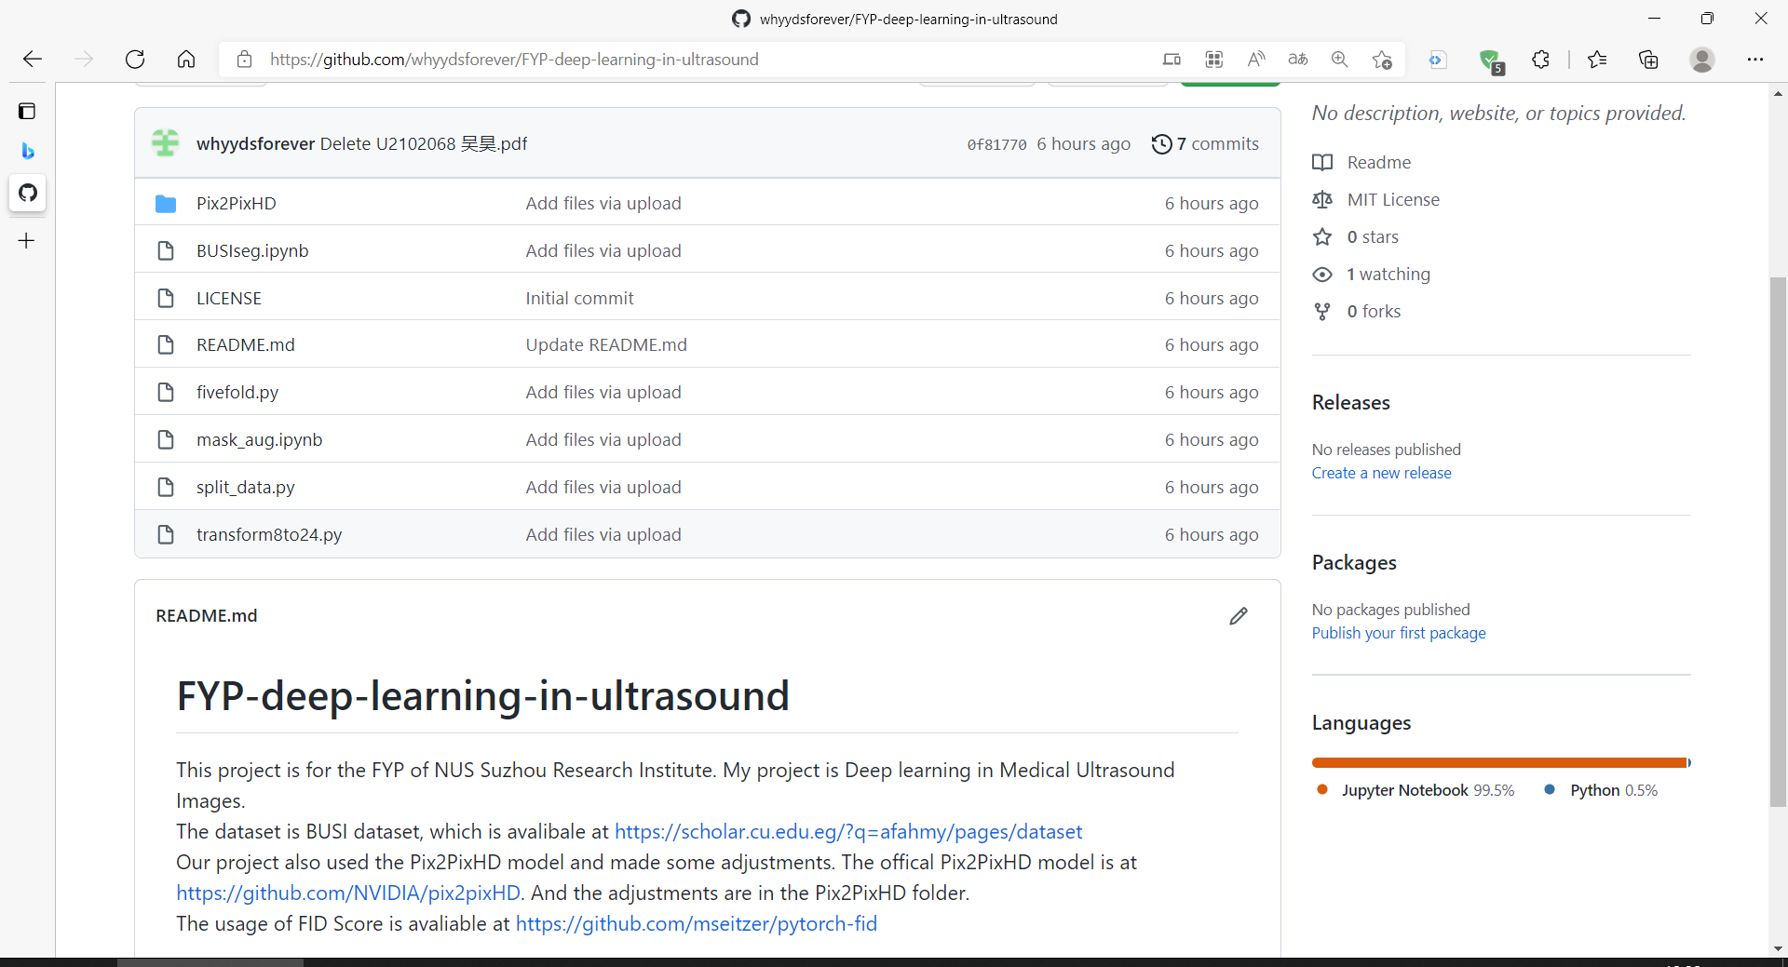
Upload the project to GitHub
whyydsforever/FYP-deep-learning-in-ultrasound (github.com)
19

Slide 21
Introduction
Literature Review
Experiments
Results and Discussion
Future Recommendations
CONTENTS
20

Slide 22
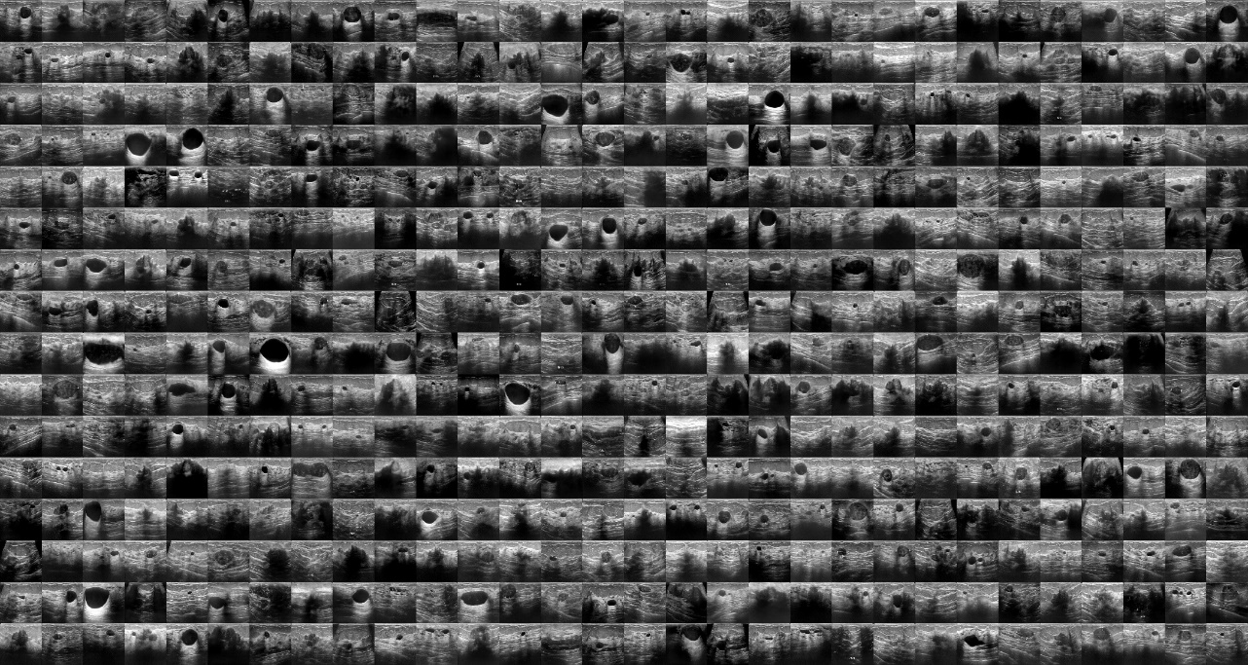
StyleGAN2-ada Results
Use ADA method can reduce the images needed for training.
Better performance on FID score.
Unable to generate corresponding masks
62.10 FID score at best
21

Slide 23
Thank you!
22

Slide 24
Why Unet?
The Unet model achieved very great performance so that it becomes the baseline for many articles in the medical image segmentation area. There are several reasons for the extensive applications of Unet. One is because of the characteristics of Unet that the depth of the network provides a larger field of view and the losing edge features in the downsampling can be retrieved by applying concatenation with a feature map. The other reason is because of the characteristics of medical images. All the features of medical images are really important so the skip connection structure of Unet works. The medical datasets are usually very small so Unet, which is light and simple, can reduce calculation and give researchers more chances to modify the Unet to better adapt to a specific task.

Slide 25
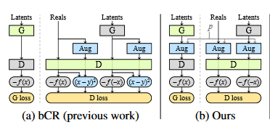
StyleGAN2-ada
When training StyleGAN or StyleGAN2, large amount of data is always needed. However, large dataset is hard to collect. So, researches try to use data augmentation method during training. But there is a problem that the data augmentation method will influence the output, for example using noise method when training GANs, the synthesized image will have noise too. This phenomena is not what we want. As a result, they proposed ada method, which is short for adaptive discriminator augmentation.
bCR means when using two data augmentation methods on the same image, the output should be the same as well. But ada thought bCR only augment discriminator is not convincing. So, in the ada method augment all the images and add the probability P to decide whether augment the image or not.

